Slide 1




STACK OVERFLOW
DEVELOPER
SURVEY RESULTS
Siranjeevi B
27/12/2023

Slide 2

OUTLINE
Executive Summary
Introduction
Methodology
Results
Visualization – Charts
Dashboard
Discussion
Findings & Implications
Conclusion
Appendix

Slide 3

EXECUTIVE SUMMARY
Data analysis goal
Methodology description:
Data collecting
Data analysis
Data visualization
Key findings are presented with graphs
Discussion
Final conclusions

Slide 4

INTRODUCTION
Stack Overflow, a popular website for
developers, conducted an online survey of software professionals across the world
The survey data was later open sourced by Stack Overflow
The actual data set has around 90,000 responses
This randomised subset contains around 1/10th of the original data set. Any conclusions you draw after analyzing this subset may not reflect the real world scenario

Slide 5

METHODOLOGY
Collecting and exploration of the survey data
Web Scraping
APIs
Data wrangling
Exploratory data analysis
Data visualization in Cognos Dashboard Embedded

Slide 6
RESULTS

Slide 7
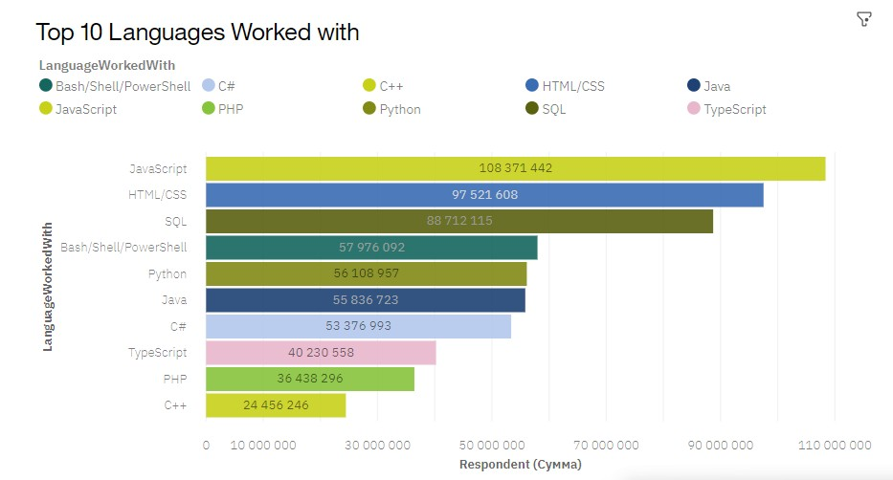
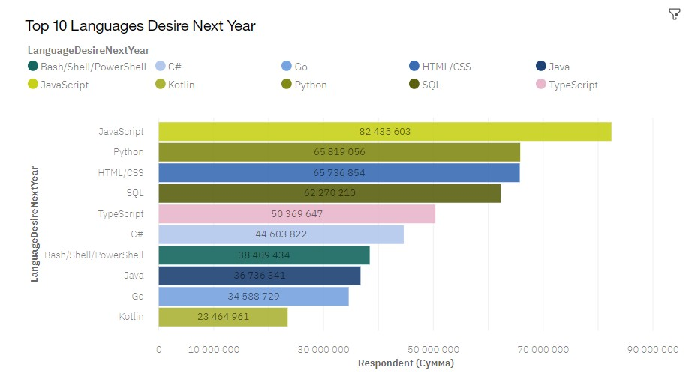
PROGRAMMING LANGUAGE TRENDS
Current Year Next Year

Slide 8
PROGRAMMING LANGUAGE TRENDS - FINDINGS & IMPLICATIONS
Findings Implications
JavaScript is the most popular programming language
The interest for Python is growing fast.
The usage of TypeScript is going to grow
However, less developers are going to work with JavaScript next year
Developers migration from other languages to python

Slide 9
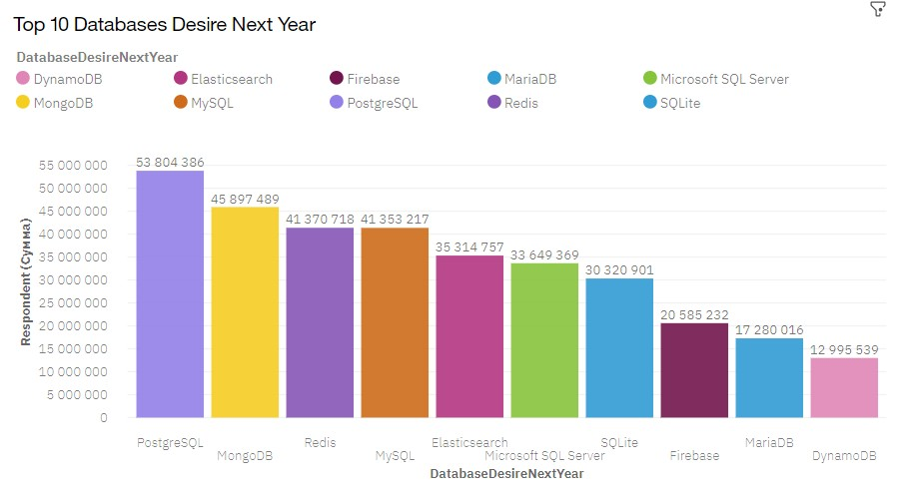
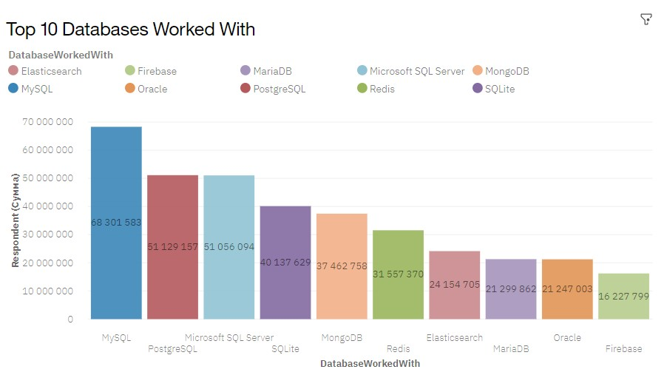
DATABASE TRENDS
Current Year
Next Year

Slide 10
DATABASE TRENDS - FINDINGS & IMPLICATIONS
Findings Implications
MySQL is the most popular database now
PostgreSQL and MS SQL Server are in Top3
The great change in database trends is expected next year
Fast growing share of MongoDB, Redis, Elasticsearch

Slide 11

DASHBOARD
https://dataplatform.cloud.ibm.com/dashboards/0b3fb618- bc27-442b-9e99-
2951f3afec31/view/0220fb76679b33d115d0b5e407cc7e057
8612408babbd156d3d47b495c667097a96e1091c82f185fda 405364a5bd475c98

Slide 12
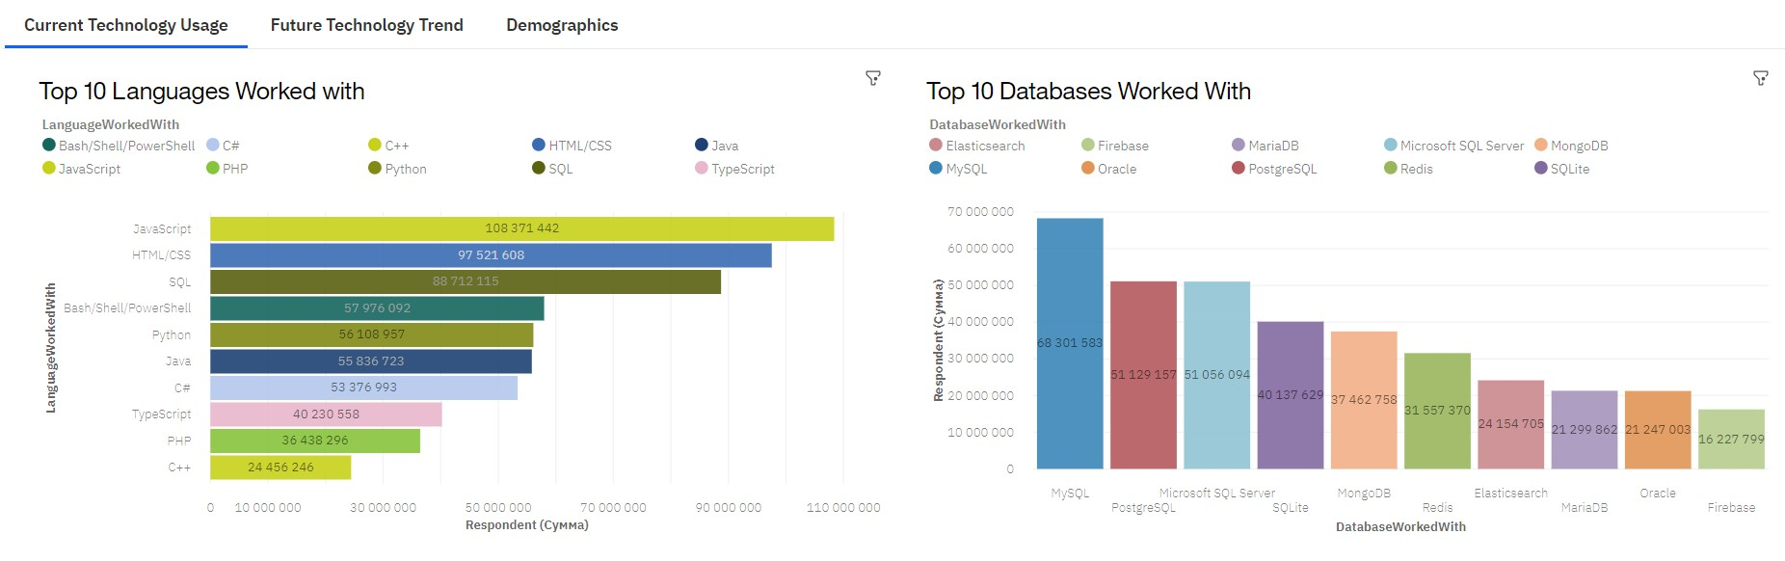
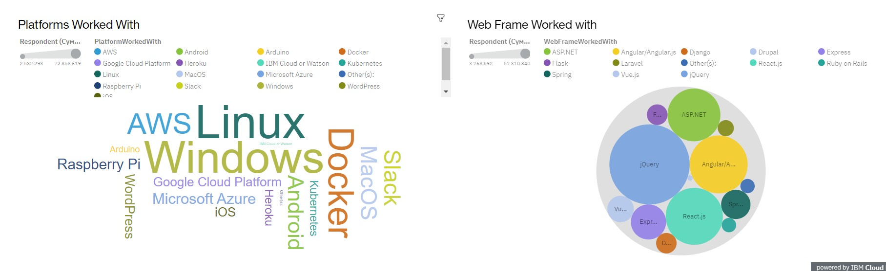
DASHBOARD TAB 1
Screenshot of dashboard tab 1 goes here

Slide 13
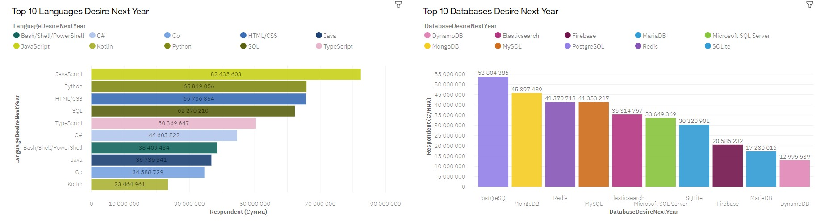
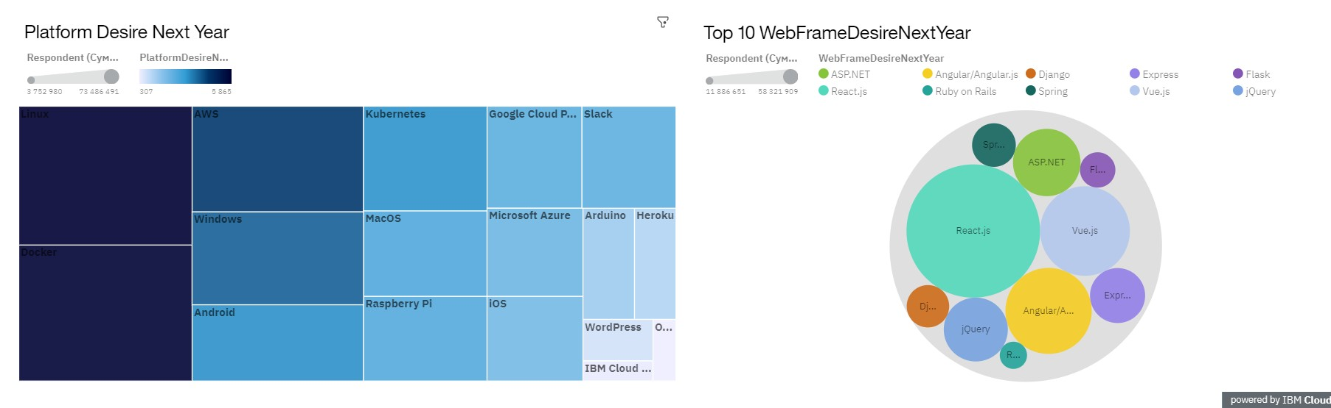
DASHBOARD TAB 2
Screenshot of dashboard tab 2 goes here

Slide 14
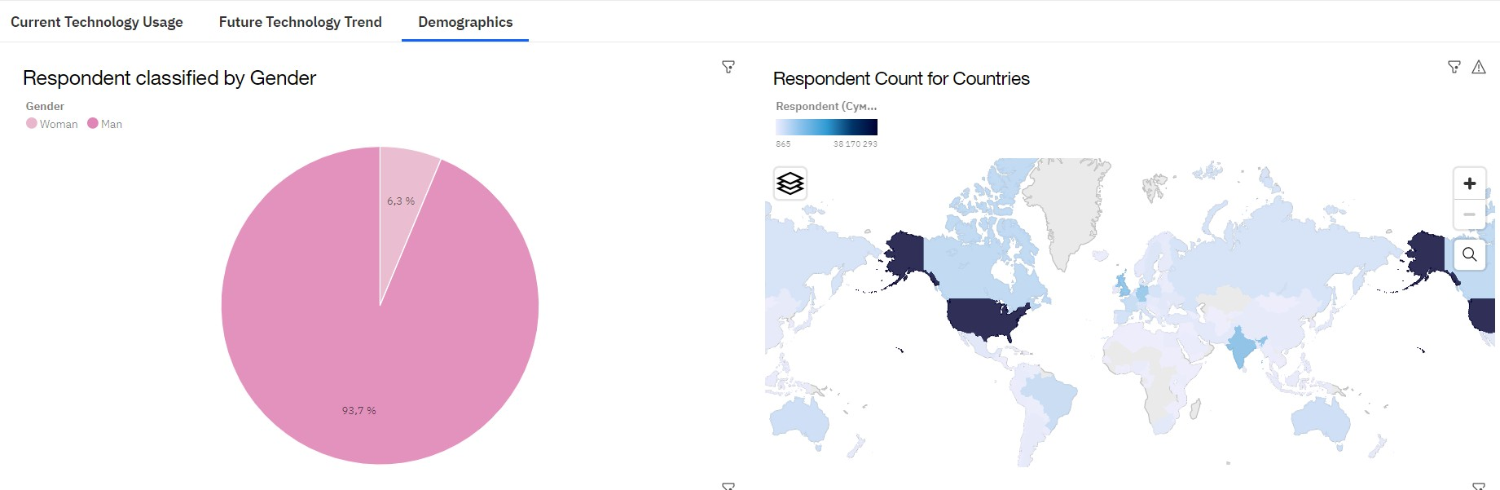
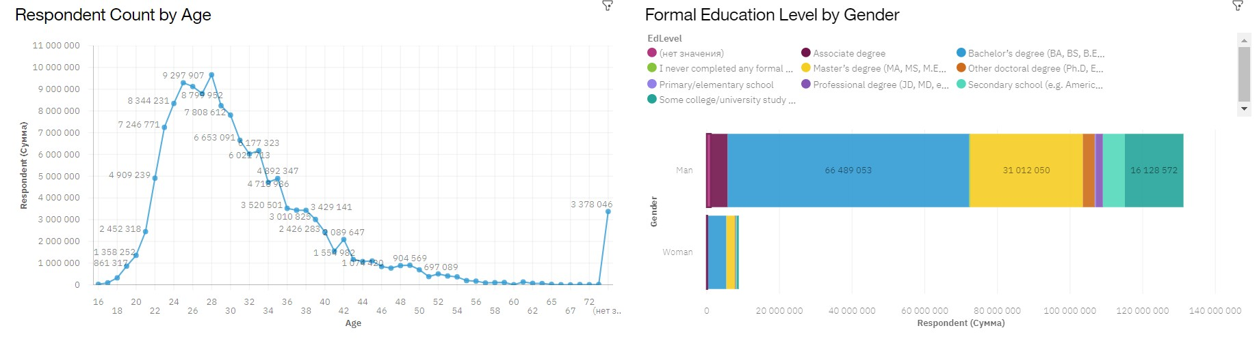
DASHBOARD TAB 3
Screenshot of dashboard tab 3 goes here

Slide 15
DISCUSSION
Do you have any questions?

Slide 16
OVERALL FINDINGS & IMPLICATIONS
Findings Implications
Only 6,3 % of developers are women.
The majority of developers are younger the 40 years
Developers are mostly located in developed countries
Java Script remains the most popular language
Global polarization of developers by age and gender

Slide 17

CONCLUSION
Python is the programming language with fast growing number of users
Fast growing share of such databases as MongoDB, Redis, Elasticsearch is expected
Majority of developers are men

Slide 18

APPENDIX

Slide 19
JOB POSTINGS
Washington DC
Detroit Seattle New York Los Angeles
San Francisco
Austin
0
1000
2000 3000
Number of Jobs
4000
5000
6000

Slide 20
POPULAR LANGUAGES
Swift
Python
C++
Javascript
Java
Go R C# SQL PHP
0
20000
40000
60000 80000
Average Annual Salary
100000
120000
140000

